Slide 1
Creating Processor System
XUP

Slide 2
Objectives
After completing this module, you will be able to:
Describe embedded system development flow in Zynq
List the steps involved in creating hardware accelerator
State how hardware accelerator created in Vitis HLS is used in Vivado Design Suite

Slide 3
Outline
Embedded System Design in Zynq using IP Integrator
Creating IP-XACT Hardware Accelerator
Integrating the IP-XACT Hardware Accelerator in AXI System
Summary

Slide 4
Embedded Design Architecture in Zynq
Embedded design in Zynq is based on:
Processor and peripherals
Dual ARM® Cortex™ -A9 processors of Zynq-7000 SoC
AXI interconnect
AXI component peripherals
Reset, clocking, debug ports
Software platform for processing system
Standalone OS
C language support
Processor services
C drivers for hardware
User application
Interrupt service routines (optional)

Slide 5
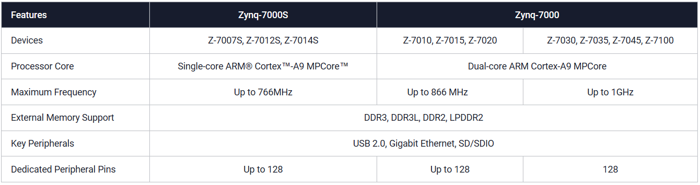
The PS and the PL
The Zynq-7000 SoC architecture consists of two major sections
PS: Processing system
Single/Dual ARM Cortex-A9 processor based (Single core versions available)
Multiple peripherals
Hard silicon core
PL: Programmable logic
Uses the same 7 series programmable logic

Slide 6
Vivado
What are Vivado, IP Integrator and Vitis?
Vivado is the tool suite for Xilinx FPGA design and includes capability for embedded system design
IP Integrator, is part of Vivado and allows block level design of the hardware part of an Embedded system
Vivado includes all the tools, IP, and documentation that are required for designing systems with the Zynq-7000 SoC hard core and/or Xilinx MicroBlaze soft core processor
Vivado + IPI replaces ISE/EDK
Vitis core development kit includes comprehensive developer tools to design, debug, and deploy software applications targeted towards embedded processors
Xilinx Zynq, MPSoC, RFSoC, and ACAP devices.
Vivado is the overall project manager and is used for developing non-embedded hardware and instantiating embedded systems
Vivado/IP Integrator flow is recommended for developing Zynq embedded systems

Slide 7
Vivado
What are Vivado, IP Integrator and SDKVitis?
Vivado is the tool suite for Xilinx FPGA design and includes capability for embedded system design
IP Integrator, is part of Vivado and allows block level design of the hardware part of an Embedded system
Integrated into Vivado
Vivado includes all the tools, IP, and documentation that are required for designing systems with the Zynq-7000 SoC hard core and/or Xilinx MicroBlaze soft core processor
Vivado + IPI replaces ISE/EDK
Vitis core development kit includes comprehensive developer tools to design, debug, and deploy software applications targeted towards embedded processors
Xilinx Zynq, MPSoC, RFSoC, and ACAP devices.
SDK is an Eclipse-based software design environment
Enables the integration of hardware and software components
Links from Vivado
Vivado is the overall project manager and is used for developing non-embedded hardware and instantiating embedded systems
Vivado/IP Integrator flow is recommended for developing Zynq embedded systems

Slide 8
Embedded System Tools: Hardware
Hardware development tools
IP Integrator
IP Packager
Hardware netlist generation
Simulation model generation
Hardware debugging using Vivado analyzer cores

Slide 9
Embedded System Tools: Software
Vitis Unified Software Platform
Board support package creation
GNU software development tools
C/C++ compiler for the MicroBlaze and ARM Cortex-A9 processors (gcc)
Debugger for the MicroBlaze and ARM Cortex-A9 processors (system debugger)
TCF framework – multicore debug
Feature
Importing target platform definition created using Vivado® Design Suite
Application development for single, multi-processor and heterogenous processor systems
Ability to create and configure board support packages (BSPs) for third-party OS
Board bring-up and Firmware development
System-level performance analysis and benchmarking
Real-time debug and trace of heterogeneous embedded systems

Slide 10
Embedded System Tools: Software
Eclipse IDE-based Software Development Kit (SDK)
Board support package creation
GNU software development tools
C/C++ compiler for the MicroBlaze and ARM Cortex-A9 processors (gcc)
Debugger for the MicroBlaze and ARM Cortex-A9 processors (system debugger)
TCF framework – multicore debug
Board support packages (BSPs)
Stand-alone BSP
Free basic device drivers and utilities from Xilinx
NOT an RTOS

Slide 11
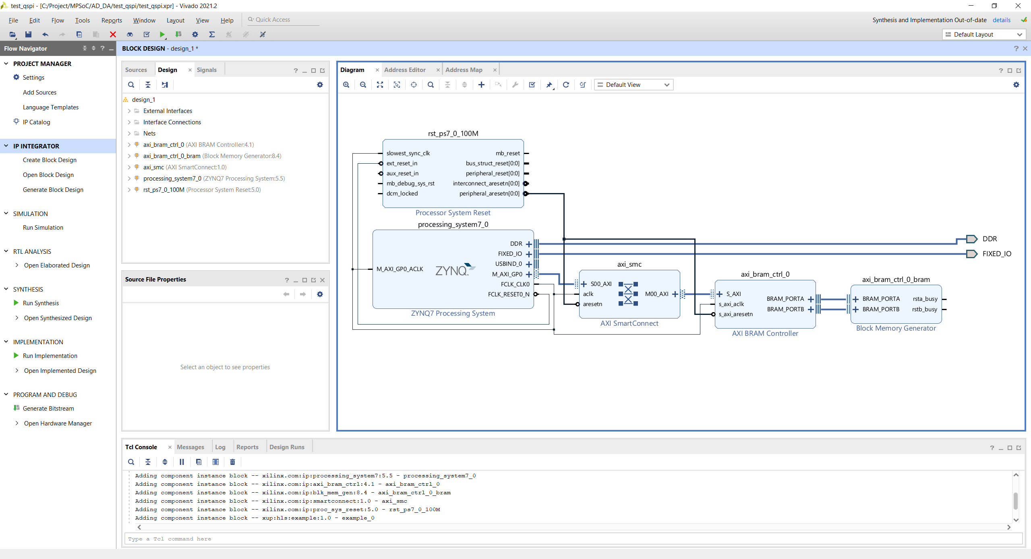
Vivado View
D
Customizable panels
A: Project Management
B: IP Integrator
C: FPGA Flow
D: Layout Selection
E: Project view/Preview Panel
F: Console, Messages, Logs
A
B
E
C
F

Slide 12
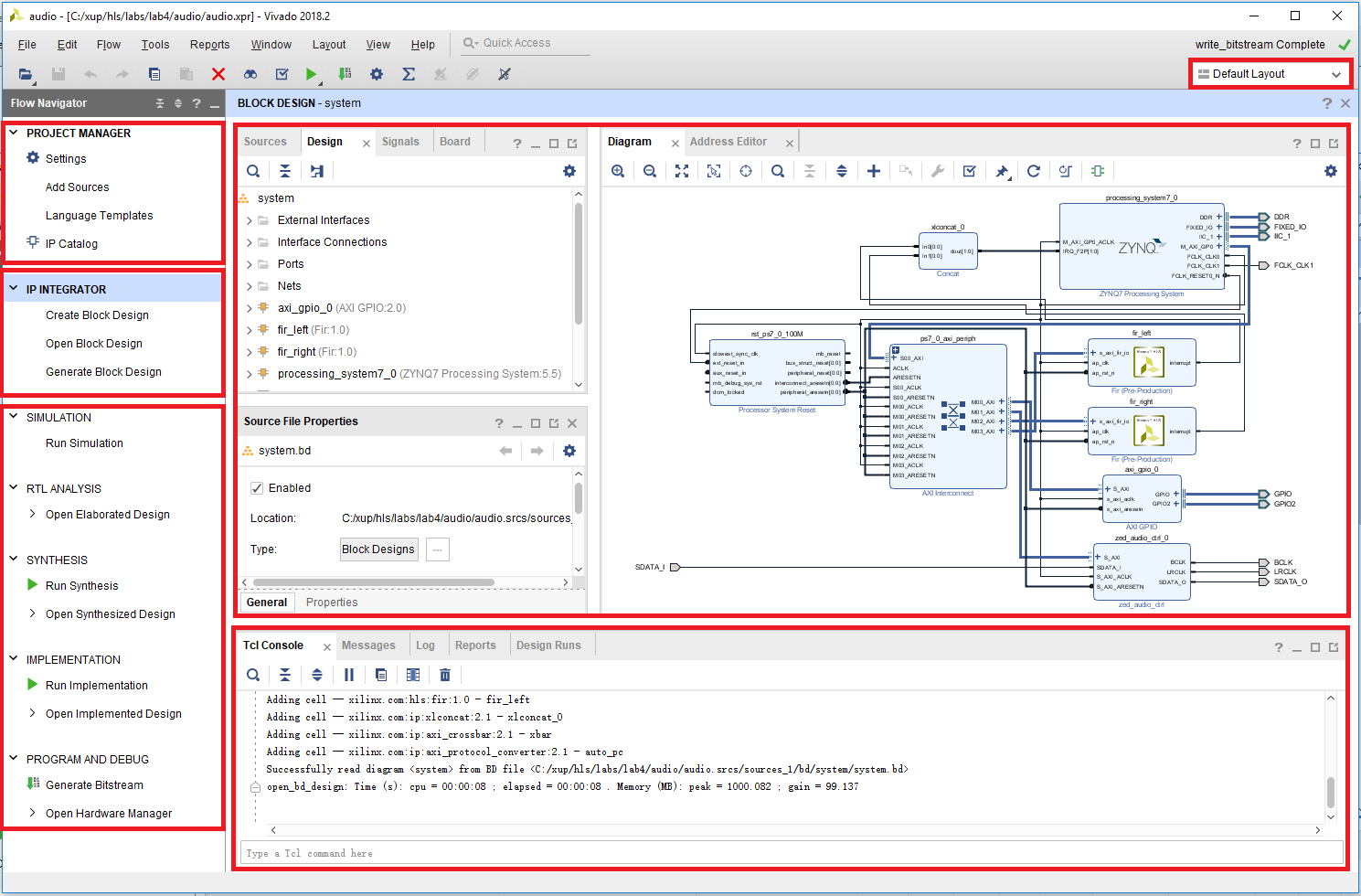
Vivado View
D
Customizable panels
A: Project Management
B: IP Integrator
C: FPGA Flow
D: Layout Selection
E: Project view/Preview Panel
F: Console, Messages, Logs
A
B
E
C
F

Slide 13
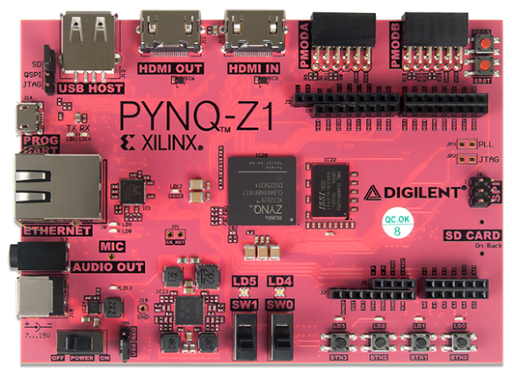
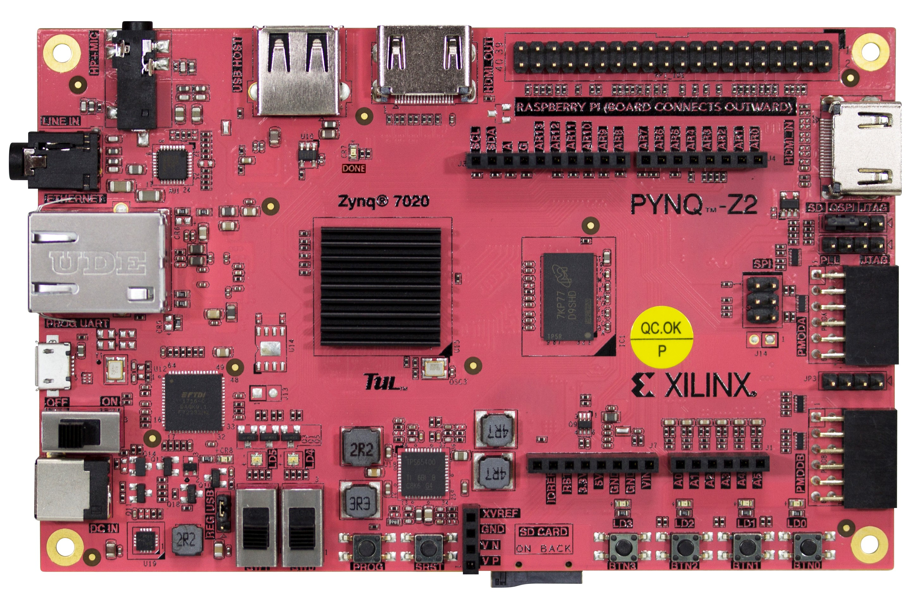
Embedded System Design using Vivado
1. Launch Vivado
2. Create Block Design
8. Create Top-Level HDL
9. Add Constraints (file)
10. Generate Bitstream => .bit
11. Export hardware to VITIS
3. Add PS7
4. Configure PS settings
5. Run Block Automation
6. Add and configure IPs
7. Run Connection Automation
IP Integrator
12. Create platform project from XSA
13. Create or add Software Project
14. Build application => .elf
VITS
Vivado
15. Program bitstream & .elf into Zynq
PYNQ-Z1
PYNQ-Z2

Slide 14
Embedded System Design using Vivado
1. Launch Vivado
2. Create Block Design
8. Create Top-Level HDL
9. Add Constraints (file)
10. Generate Bitstream => .bit
11. Export hardware to VITIS
3. Add PS7
4. Configure PS settings
5. Run Block Automation
6. Add and configure IPs
7. Run Connection Automation
IP Integrator
12. Create Board Support Package
12. Create platform project from XSA
13. Create or add Software Project
14. Build application => .elf
VITS
Vivado
15. Program bitstream & .elf into Zynq
PYNQ-Z1
PYNQ-Z2

Slide 15
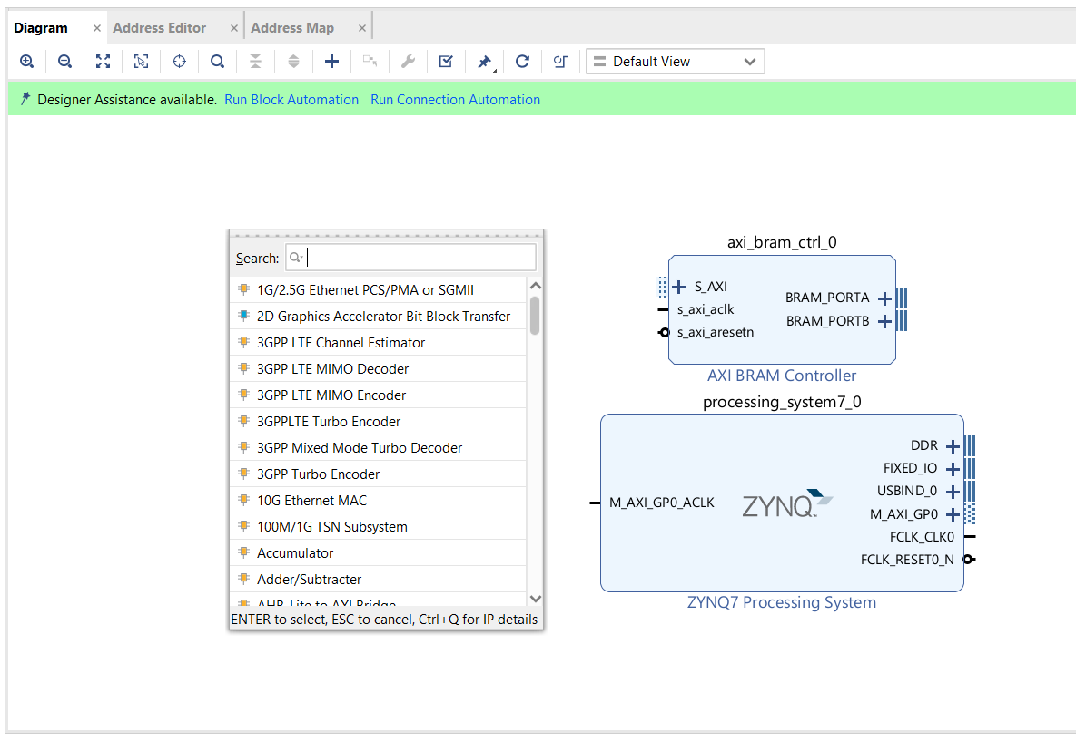
Add IP Integrator Block Diagram
IP Integrator Block Diagram opens a blank canvas
IP can be added from the IP catalog
Drag and drop interface
Intelligent Design environment
Design Assistance
Connection automation
Highlights valid connections
Group, create hierarchal blocks
Can import custom IP using IP Packager

Slide 16
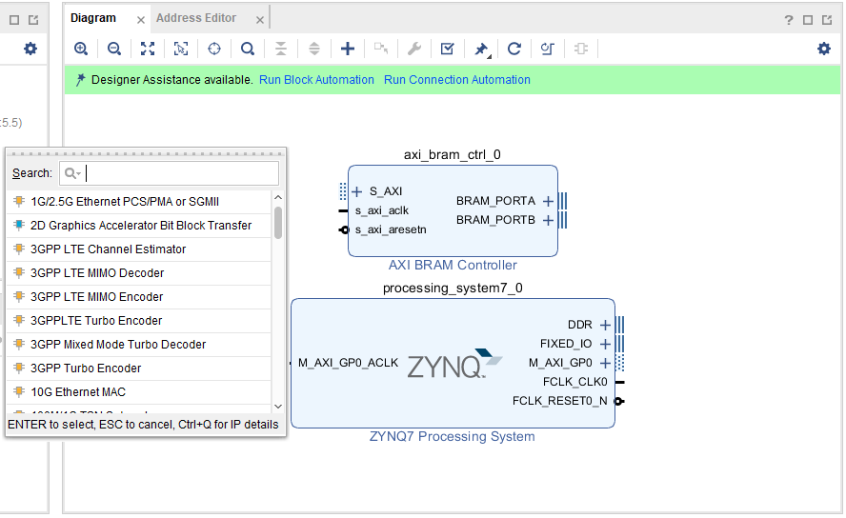
Add IP Integrator Block Diagram
IP Integrator Block Diagram opens a blank canvas
IP can be added from the IP catalog
Drag and drop interface
Intelligent Design environment
Design Assistance
Connection automation
Highlights valid connections
Group, create hierarchal blocks
Can import custom IP using IP Packager

Slide 17
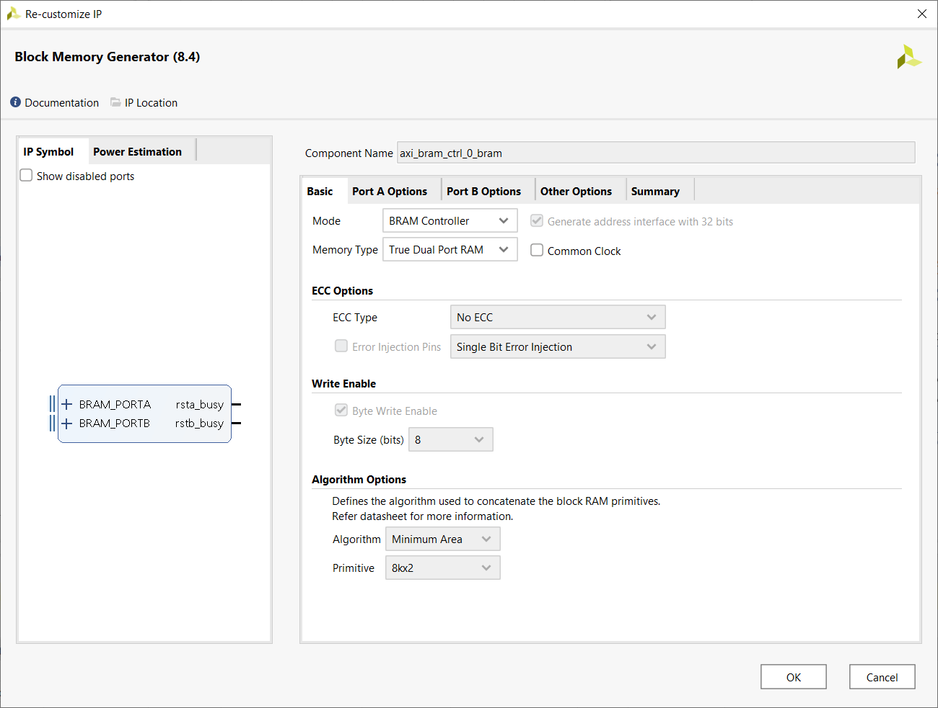
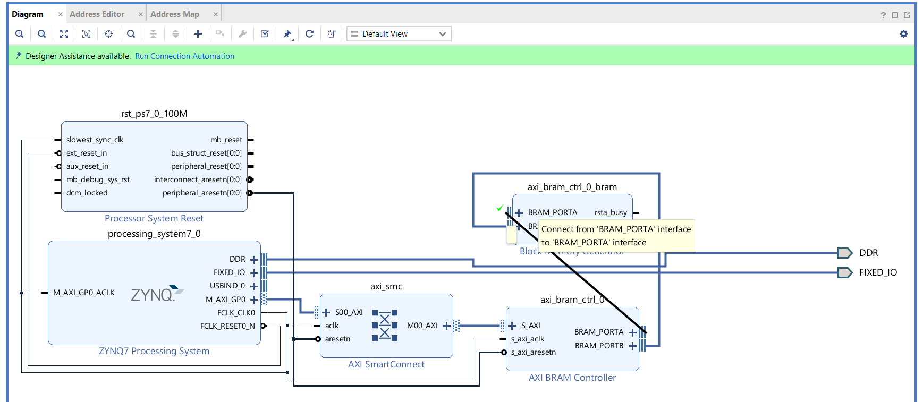
Configuring and Connecting Hardware in IP Integrator
Double click blocks to access configuration options
Drag pointer to make connections
Highlights valid connections
Connection Automation
Automatically connect recognised interfaces
Automatically redraw system

Slide 18
Add IP Integrator Block Diagram
IP Integrator Block Diagram opens a blank canvas
IP can be added from the IP catalog
Drag and drop interface
Intelligent Design environment
Design Assistance
Connection automation
Highlights valid connections
Group, create hierarchal blocks
Can import custom IP using IP Packager

Slide 19
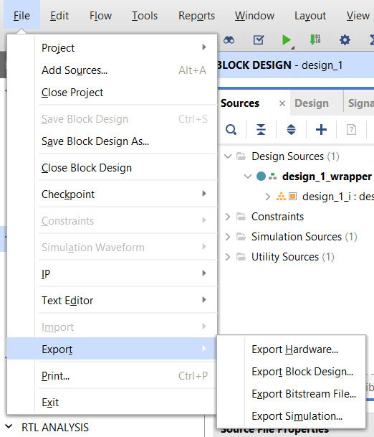
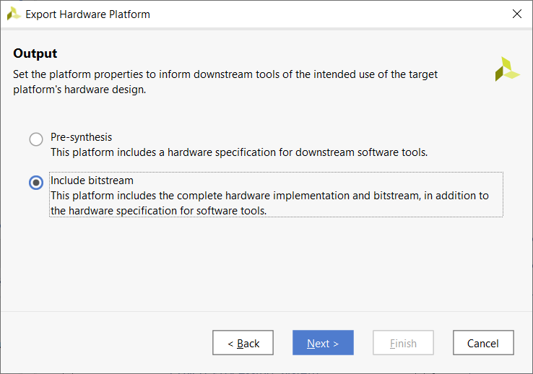
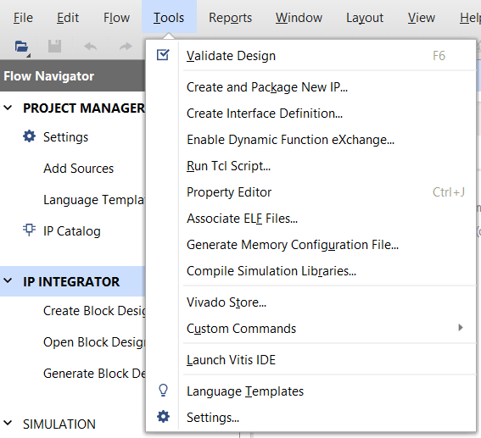
Exporting to VITIS
Export hardware platform first
The XSA file has the hardware specifications like processor configuration properties, peripheral connection information, address map, and device initialization code.
Include bitstream if generated
Launch VITIS
Software development is performed with the Vitis Unified Software Platform
The VITIS tool will then associate user software projects to hardware

Slide 20
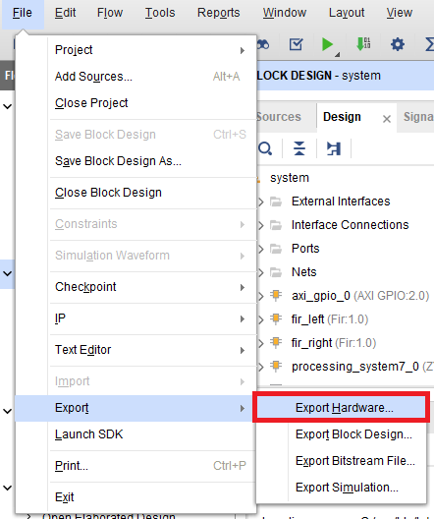
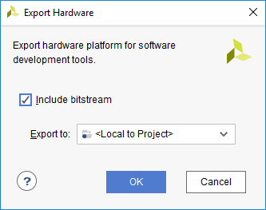
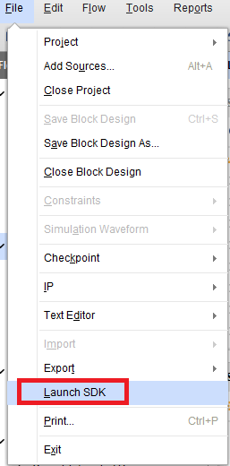
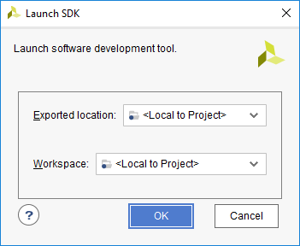
Exporting to VITIS
Export hardware platform first
The Hardware Description File (hdf) format file containing all the relevant information will be created and placed under the *.sdk directory
The XSA file has the hardware specifications like processor configuration properties, peripheral connection information, address map, and device initialization code.
Include bitstream if generated
Launch XSDKVITIS
Software development is performed with the Xilinx Software Development Kit tool (XSDK)
Software development is performed with the Vitis Unified Software Platform
The XSDKVITIS tool will then associate user software projects to hardware

Slide 21
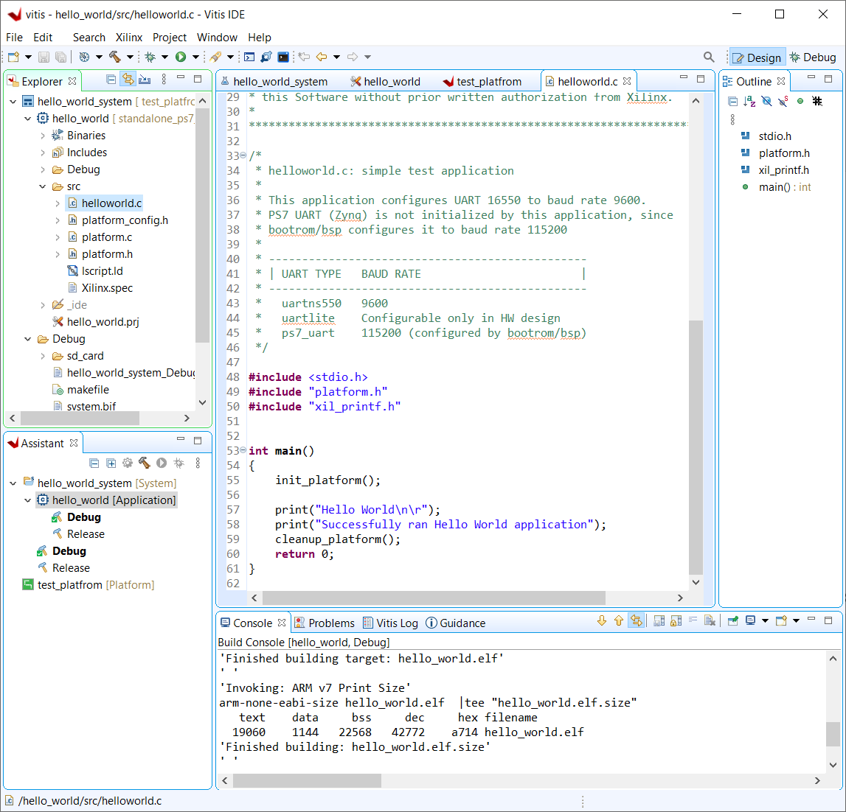
Software Development Flow
Create/Import platform project
Import Hardware Spec from XSA to Vitis
Domain Creation
Create software application
Update linker script, if needed
Build project
compile, assemble, link output file <app_project>.elf

Slide 22
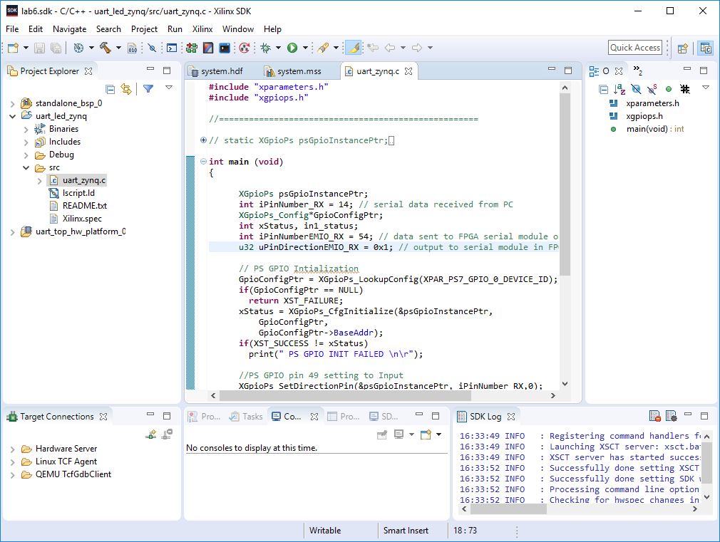
Software Development Flow
Create/Import hardware platform project
Automatically performed when XSDK tool is launched from Vivado project
Import Hardware Spec from XSA to Vitis
Domain Creation
Create BSP
System software, board support package
Create software application
Update linker script, if needed
Build project
compile, assemble, link output file <app_project>.elf

Slide 23
Creating IP-XACT Hardware Accelerator

Slide 24
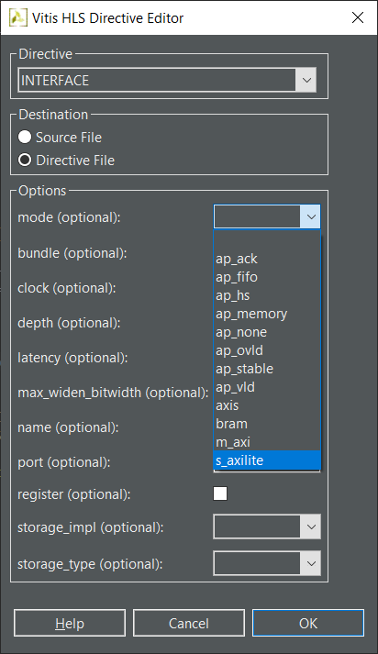
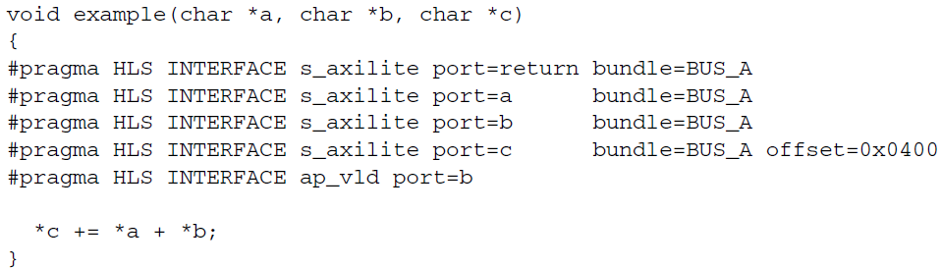
Port-Level Interfaces
The AXI4 interfaces supported by Vitis HLS include
The AXI4-Stream (axis)
Specify on input arguments or output arguments only, not on input/output arguments
The AXI4 master (m_axi)
Specify on arrays and pointers (and references in C++) only. You can group multiple arguments into the same AXI4 interface using the bundle option
The AXI4-Lite (s_axilite)
Specify an AXI4-Lite slave I/O protocol on any type of argument except streams. You can group multiple arguments into the same AXI4-Lite interface using the bundle option

Slide 25
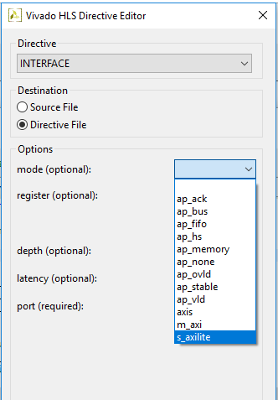
Port-Level Interfaces
The AXI4 interfaces supported by Vitis HLS include
The AXI4-Stream (axis)
Specify on input arguments or output arguments only, not on input/output arguments
The AXI4 master (m_axi)
Specify on arrays and pointers (and references in C++) only. You can group multiple arguments into the same AXI4-LiteAXI4 interface using the bundle option
The AXI4-Lite (s_axilite)
Specify on any type of argument except arrays. Specify an AXI4-Lite slave I/O protocol on any type of argument except streams. You can group multiple arguments into the same AXI4-Lite interface using the bundle option

Slide 26
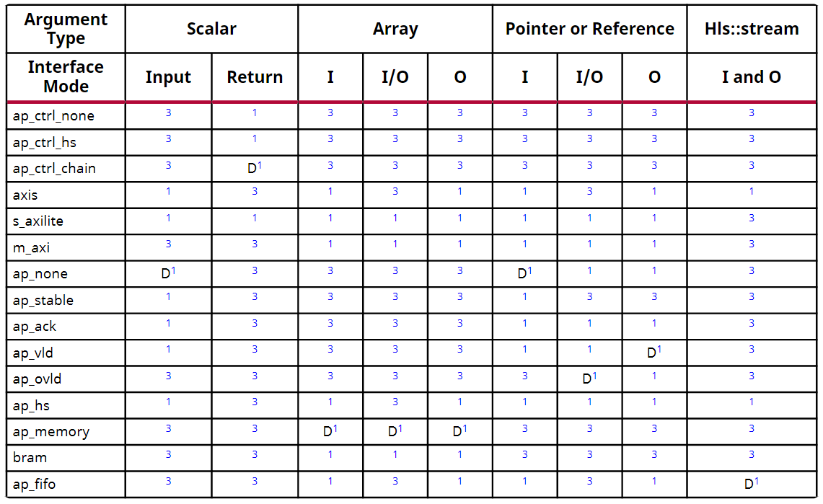
Interface Modes
Native AXI Interfaces
AXI4 Slave Lite, AXI4 Master, AXI Stream supported by INTERFACE directive
Provided in RTL after Synthesis
Supported by C/RTL Co-simulation
Supported for Verilog and VHDL
BRAM Memory Interface
Identical IO protocol to ap_memory
Bundled differently in IP Integrator
Provides easier integration to memories with BRAM interface
Block Level Protocol
AXI4 Interfaces
No IO Protocol
Wire handshake
protocols
Memory protocols
: RAM
: FIFO

Slide 27
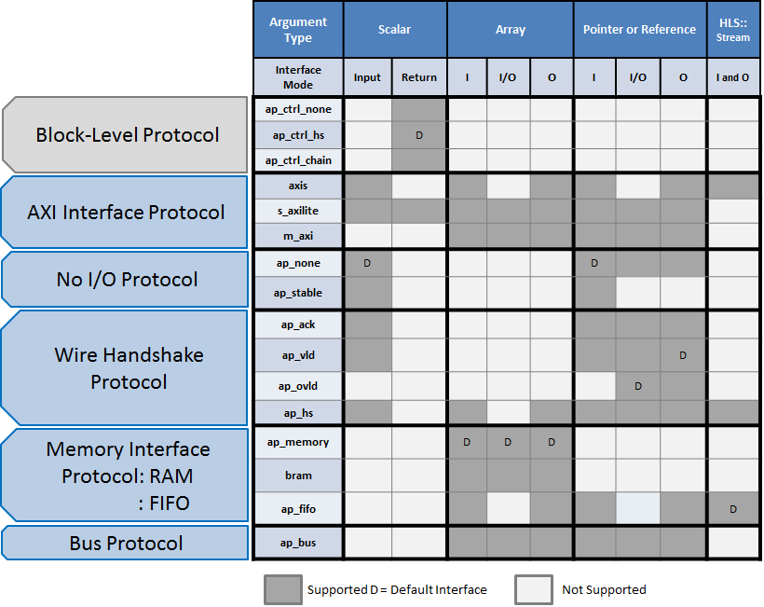
Interface Modes
Native AXI Interfaces
AXI4 Slave Lite, AXI4 Master, AXI Stream supported by INTERFACE directive
Provided in RTL after Synthesis
Supported by C/RTL Co-simulation
Supported for Verilog and VHDL
BRAM Memory Interface
Identical IO protocol to ap_memory
Bundled differently in IP Integrator
Provides easier integration to memories with BRAM interface
axis
s_axilite
m_axi
Block Level Protocol
AXI4 Interfaces
No IO Protocol
bram
Wire handshake
protocols
Memory protocols
: RAM
: FIFO

Slide 28
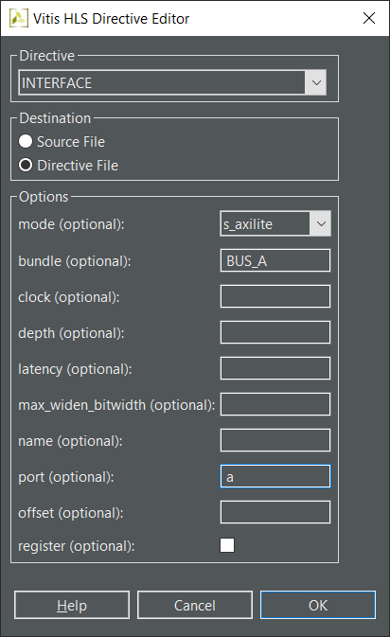
Native AXI Slave Lite Interface
Interface Mode: s_axilite
Supported with INTERFACE directive
Multiple ports may be grouped into the same Slave Lite interface
All ports which use the same bundle name are grouped
Grouped Ports
Default mode is ap_none for input ports
Default mode is ap_vld for output ports
Default mode ap_ctrl_hs for function return
Default mode can be changed with additional INTERFACE directives
void example(char *a, char *b, char *c)
{
#pragma HLS INTERFACE mode=s_axilite port=a bundle=BUS_A
#pragma HLS INTERFACE mode=s_axilite port=b bundle=BUS_A
#pragma HLS INTERFACE mode=s_axilite port=c bundle=OUT
#pragma HLS INTERFACE mode=s_axilite port=return bundle=BUS_A
#pragma HLS INTERFACE mode=ap_vld port=b
*c += *a + *b;
}
Notes:
Ug1399 Page 264 S_AXILITE and Port-Level Protocols

Slide 29
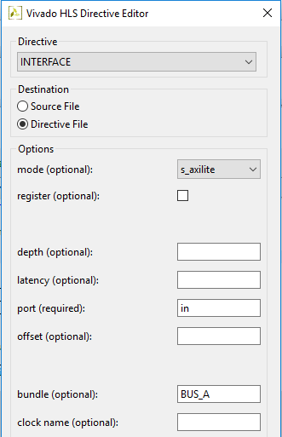
Native AXI Slave Lite Interface
Interface Mode: s_axilite
Supported with INTERFACE directive
Multiple ports may be grouped into the same Slave Lite interface
All ports which use the same bundle name are grouped
Grouped Ports
Default mode is ap_none for input ports
Default mode is ap_vld for output ports
Default mode ap_ctrl_hs for function return
Default mode can be changed with additional INTERFACE directives
void example(char *a, char *b, char *c)
{
#pragma HLS INTERFACE mode=s_axilite port=a bundle=BUS_A
#pragma HLS INTERFACE mode=s_axilite port=b bundle=BUS_A
#pragma HLS INTERFACE mode=s_axilite port=c bundle=OUT
#pragma HLS INTERFACE mode=s_axilite port=return bundle=BUS_A
#pragma HLS INTERFACE mode=ap_vld port=b
*c += *a + *b;
}
void example(char *a, char *b, char *c)
{
#pragma HLS INTERFACE s_axilite port=return bundle=BUS_A
#pragma HLS INTERFACE s_axilite port=a bundle=BUS_A
#pragma HLS INTERFACE s_axilite port=b bundle=BUS_A
#pragma HLS INTERFACE s_axilite port=c bundle=BUS_A
#pragma HLS INTERFACE ap_hs port=a
#pragma HLS INTERFACE ap_vld port=b
#pragma HLS INTERFACE ap_none port=c register
Notes:
Ug1399 Page 264 S_AXILITE and Port-Level Protocols

Slide 30
Controllable Register Maps in AXI4 Lite
Assigning offset to array (RAM) interfaces
Specified value is offset to base of array
Array’s address space is always contiguous and linear
C Driver Files include offset information
In generated driver file xhls_sig_gen_bram2axis.h
void hls_sig_gen_bram2axis(hls::stream<axis_last_t<data_t> >& dout,
data_t sig_buf[MAX_SIG_PERIOD], short sig_period)
{
#pragma HLS INTERFACE port=return mode=s_axilite bundle=ctrl
#pragma HLS INTERFACE port=sig_buf mode=s_axilite bundle=ctrl offset=0x1000
#pragma HLS INTERFACE port=sig_period mode=s_axilite bundle=ctrl offset=0x0400
...
#define XHLS_SIG_GEN_BRAM2AXIS_CTRL_ADDR_SIG_PERIOD_DATA 0x0400
...
#define XHLS_SIG_GEN_BRAM2AXIS_CTRL_ADDR_SIG_BUF_BASE 0x1000
#define XHLS_SIG_GEN_BRAM2AXIS_CTRL_ADDR_SIG_BUF_HIGH 0x17ff
...
Notes:
Didn’t find match information

Slide 31
Controllable Register Maps in AXI4 Lite
Assigning offset to array (RAM) interfaces
Specified value is offset to base of array
Array’s address space is always contiguous and linear
C Driver Files include offset information
In generated driver file xhls_sig_gen_bram2axis.h
void hls_sig_gen_bram2axis(hls::stream<axis_last_t<data_t> >& dout,
data_t sig_buf[MAX_SIG_PERIOD], short sig_period)
{
#pragma HLS INTERFACE port=return mode=s_axilite bundle=ctrl
#pragma HLS INTERFACE port=sig_buf mode=s_axilite bundle=ctrl offset=0x1000
#pragma HLS INTERFACE port=sig_period mode=s_axilite bundle=ctrl offset=0x0400
...
#define XHLS_SIG_GEN_BRAM2AXIS_CTRL_ADDR_SIG_PERIOD_DATA 0x0400
...
#define XHLS_SIG_GEN_BRAM2AXIS_CTRL_ADDR_SIG_BUF_BASE 0x1000
#define XHLS_SIG_GEN_BRAM2AXIS_CTRL_ADDR_SIG_BUF_HIGH 0x17ff
...
Notes:
Didn’t find match information

Slide 32
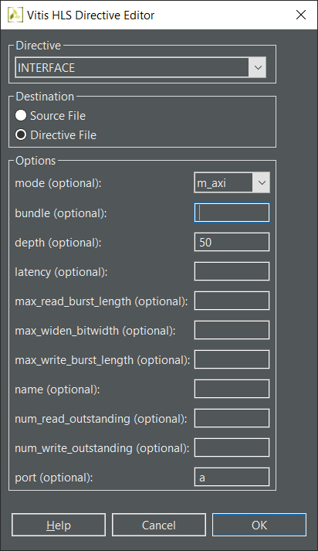
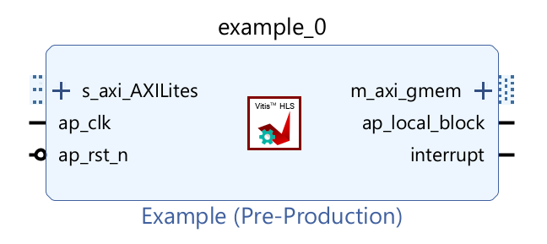
Native AXI4 Master
Interface Mode: m_axi
Supported with INTERFACE directive
Options
Multiple ports may be grouped into the same AXI4 Master interface
All ports which use the same bundle name are grouped
Depth option is required for C/RTL co-simulation
Required for pointers, not arrays
Set to the number of values read/written
Option to support offset or base address
void example(volatile int *a)
{
#pragma HLS INTERFACE mode=m_axi depth=50 port=a

Slide 33
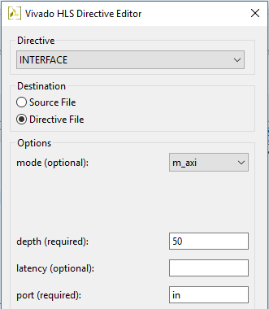
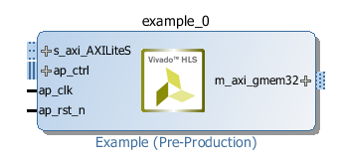
Native AXI4 Master
Interface Mode: m_axi
Supported with INTERFACE directive
Options
Multiple ports may be grouped into the same AXI4 Master interface
All ports which use the same bundle name are grouped
Depth option is required for C/RTL co-simulation
Required for pointers, not arrays
Set to the number of values read/written
Option to support offset or base address
void example(volatile int *a)
{
#pragma HLS INTERFACE m_axi depth=50 port=a

Slide 34
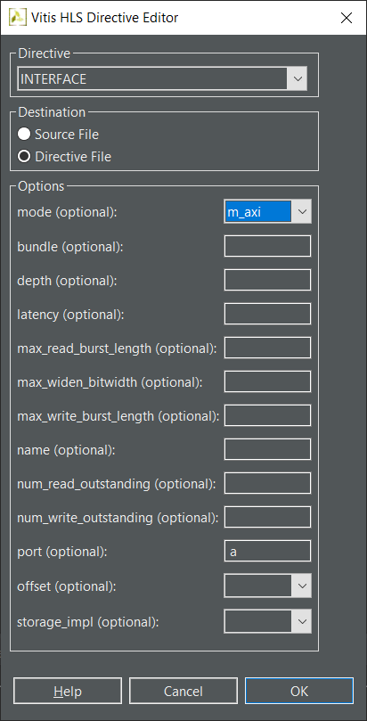
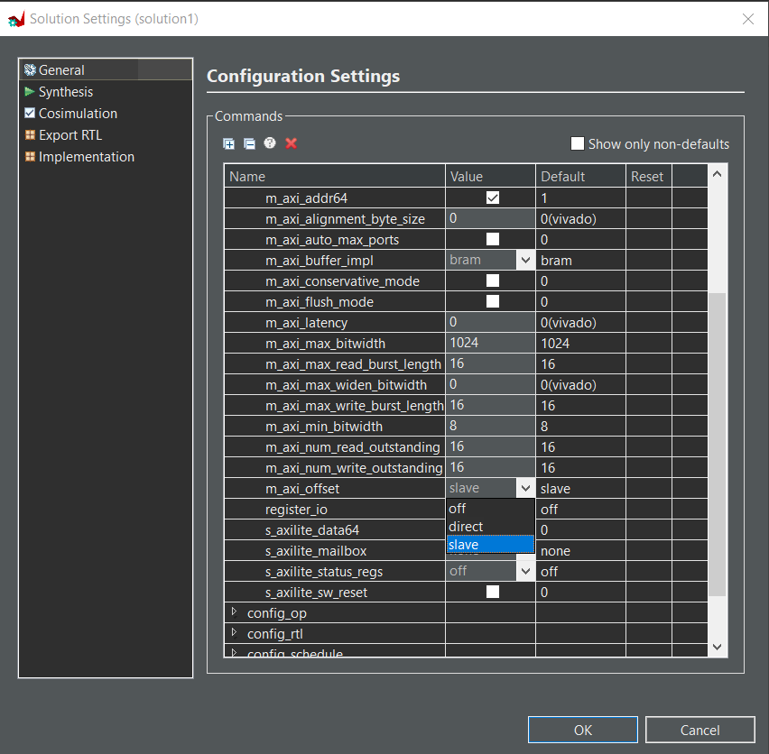
Native AXI4 Master : Offset Support
Address Offset / Base Address Support
Support provided for address offset
Port Offset
Defines the offset for the port
May be set on individual interfaces using the INTERFACE directive
Global Offset
Globally controls the offset ports of all M_AXI interface in the design
May be set using the interface configuration
Using Tcl command config_interface -m_axi_offset option

Slide 35
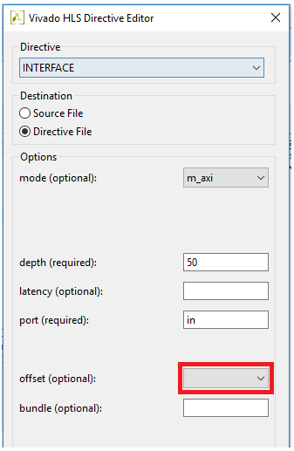
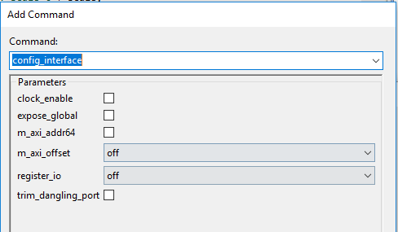
Native AXI4 Master : Offset Support
Address Offset / Base Address Support
Support provided for address offset
Port Offset
Defines the offset for the port
May be set on individual interfaces using the INTERFACE directive
Global Offset
Globally controls the offset ports of all M_AXI interface in the design
May be set using the interface configuration
Using Tcl command config_interface -m_axi_offset option

Slide 36
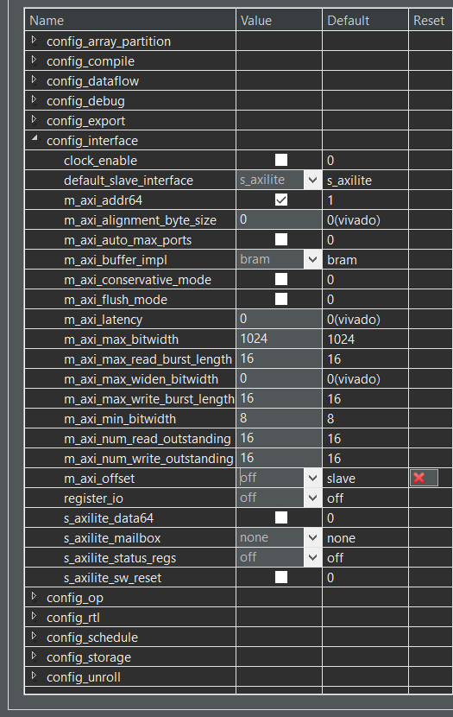
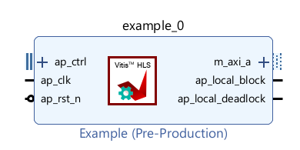
Native AXI4 Master: Offset=off
AXI4 Master Interface
No offset is provided for the address
Same as existing behavior
The offset (BASEADDR) is set IPI
Using IP customization GUI
The offset can not be changed on the fly
config_interface -m_axi_offset off
AXI4 Master Interface
Notes:
Default offset mode in document is off, but in vits command configuration is slave
测试后应该是slave，文档描述有误

Slide 37
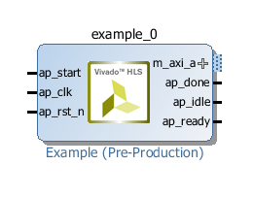
Native AXI4 Master: Offset=off (default)
Default AXI4 Master Interface
No offset is provided for the address
Same as existing behavior
The offset (BASEADDR) is set IPI
Using IP customization GUI
The offset can not be changed on the fly
config_interface -m_axi_offset off
AXI4 Master Interface
Notes:
Default offset mode in document is off, but in vits command configuration is slave
测试后应该是slave，文档描述有误

Slide 38
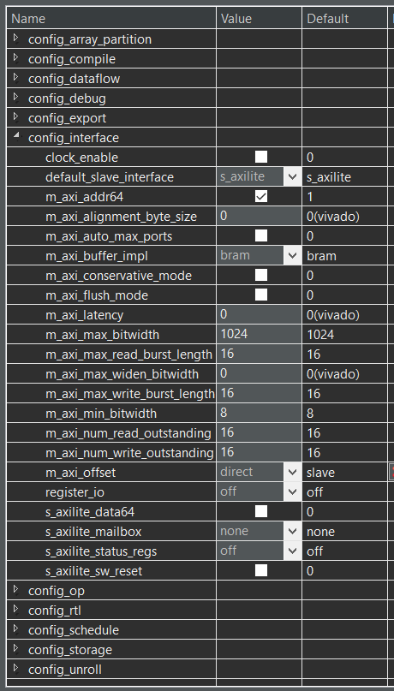
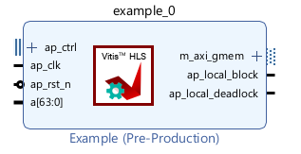
Native AXI4 Master: Offset=direct
Direct Interface
Generates a scalar input offset port
The offset is set by driving the input port
It can be changed on the fly by driving the port with a different value
config_interface -m_axi_offset direct
AXI4 Master Interface …
…Plus port to specify address offset

Slide 39
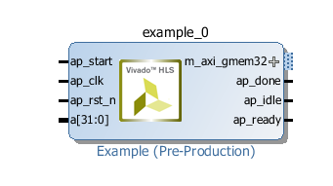
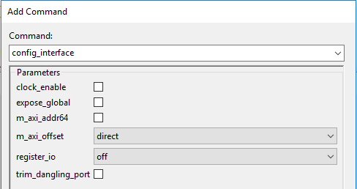
Native AXI4 Master: Offset=direct
Direct Interface
Generates a scalar input offset port
The offset is set by driving the input port
It can be changed on the fly by driving the port with a different value
config_interface -m_axi_offset direct
AXI4 Master Interface …
…Plus port to specify address offset

Slide 40
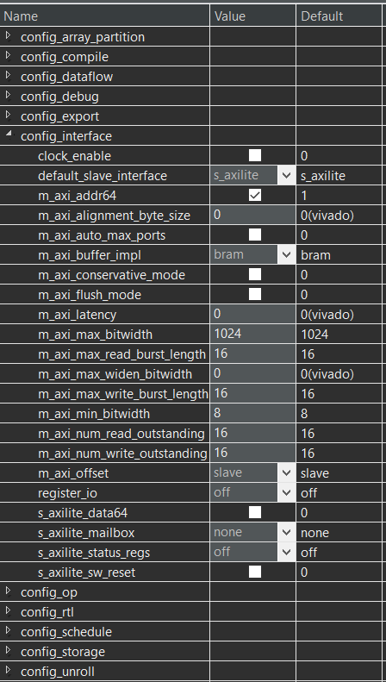
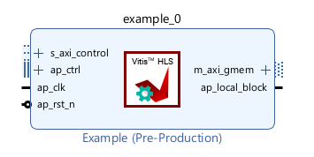
Native AXI4 Master: Offset=slave(Default)
Direct Interface
Generates an offset port and automatically maps it to an AXI4 Slave Lite interface
User must program the offset before starting transactions on the AXI4 Master interface
It can changed on the fly by re-programming the offset register
config_interface -m_axi_offset slave
AXI4 Master Interface …
…Plus AXI4 Slave Lite interface to program the address offset

Slide 41
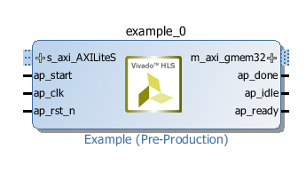
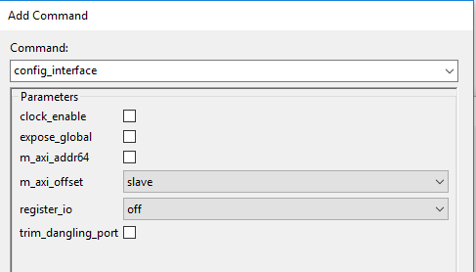
Native AXI4 Master: Offset=slave(Default)
Direct Interface
Generates an offset port and automatically maps it to an AXI4 Slave Lite interface
User must program the offset before starting transactions on the AXI4 Master interface
It can changed on the fly by re-programming the offset register
config_interface -m_axi_offset slave
AXI4 Master Interface …
…Plus AXI4 Slave Lite interface to program the address offset

Slide 42
Burst Accesses Inferred for AXI4 Master
There are two types of accesses on an AXI Master
Burst accesses are more efficient
Burst access has until now required the use of memcpy()
Burst Accesses are now inferred
From operations in a for-loop and from sequential operations in the code
However: there are some limitations
Single for-loops only, no nested loops
Single Access
Burst Access
void example(int *a)
{
#pragma HLS INTERFACE m_axi port=a depth=...
...
int val[i] = *(a + i);
...
void example(int *a)
{
#pragma HLS INTERFACE m_axi port=a depth=...
...
memcpy(vals, a, N * sizeof(int));
...

Slide 43
AXI4-Master : Burst Access with a Single Port
Burst access with single port
Loop must be pipelined
Address must be accessed in increasing order
Memory accesses cannot be guarded by a conditional statement
Do not flatten nested loops
Only one read and write per AXI port allowed in a for loop
Only one read and one write is allowed in a for loop unless the ports are bundled in different AXI ports
//Port a is assigned to an AXI4 master interface
void example(volatile int *a){
#pragma HLS INTERFACE mode=m_axi port=a depth=50
#pragma HLS INTERFACE mode= s_axilite port=return
int i;
int buff[50];
//Burst data into the Design
//memcpy creates a burst access to memory
memcpy(buff,(const int*)a,50*sizeof(int));
//Perform some calculation
for(i=0;i<50;i++){
buff[i]=buff[i]+100;
}
//Burst Dara out of the design
//Alternatively, for loop creates a burst access to memory
for(i=0;i<50;i++){
#pragma HLS PIPELINE
a[i]=buff[i];
}
}

Slide 44
AXI4-Master : Burst Access with Multiple Ports
Burst access with multiple ports
Vitis HLS implements the port reads as burst transfers
Port a is specified without using the bundle option and is implemented in the default AXI interface
Port b is specified using a named bundle and is implemented in a separate AXI interface called d2_port
In the multiple access bursts
Only one access(read or write) per port can be inferred from a for loop
No simultaneous read and write access
If multiple ports are used, multiple reads or writes can be performed
//Two pointers are accessed
void example(volatile int *a, int *b){
#pragma HLS INTERFACE mode= s_axilite port=return
//Two different AXI ports are used
#pragma HLS INTERFACE mode=m_axi port=a depth=50
#pragma HLS INTERFACE mode=m_axi port=b depth=50 bundle=d2_port
int i;
int buff[50];
//Copy data in
for(i=0;i<50;i++){
#pragma HLS PIPELINE
//separate AXI ports mean both a and b reads implemented as bursts
buff[i]=a[i]+b[i];
}
…
}

Slide 45
Burst Accesses Inferred for AXI4 Master
There are two types of accesses on an AXI Master
Burst accesses are more efficient
Burst access has until now required the use of memcpy()
Burst Accesses are now inferred
From operations in a for-loop and from sequential operations in the code
However: there are some limitations
Single for-loops only, no nested loops
Single Access
Burst Access
void example(int *a)
{
#pragma HLS INTERFACE m_axi port=a depth=...
...
int val[i] = *(a + i);
...
void example(int *a)
{
#pragma HLS INTERFACE m_axi port=a depth=...
...
memcpy(vals, a, N * sizeof(int));
...

Slide 46
Byte-Enable Accesses on AXI4 Master
Byte-Enable Accesses Support on AXI4 Master Interfaces
Single bytes are now written and read
Improved AXI4 Master performance
Improved Performance
This code uses 8-bit data
Previously, accessing this required reading/writing full 32-bit
This implied a required read-modify-write behavior: Impacted performance
Similar performance improvement when accessing struct members
Also often implied read-modify-write behavior
Improved Port Bundling
Variables of different sizes can be grouped into same AXI4 Master port
void example(volatile char *a) {
#pragma HLS INTERFACE m_axi depth=50 port=a

Slide 47
AXI4 Port Bundling
AXI4 Master and Lite Port Bundling
The bundle options groups arguments into the same AXI4 port
For example, group 3 arguments into AXI4-Lite port “ctrl” :
Arguments can be Bundled into AXI4 Master and AXI4 Lite ports
If no bundle name is used a default name is used for all arguments
All go into a single AXI4 Master or AXI4 Lite
Default name applied if no –bundle option is used
Group different sized variables into an AXI4 Master port
void hls_sig_gen_bram2axis(hls::stream<data_t>& dout,
data_t sig_buf[MAX_SIG_PERIOD], short sig_period)
{
#pragma HLS INTERFACE port=return mode=s_axilite bundle=ctrl
#pragma HLS INTERFACE port=sig_buf mode=s_axilite bundle=ctrl
#pragma HLS INTERFACE port=sig_period mode=s_axilite bundle=ctrl
#pragma HLS INTERFACE port=dout mode=axis

Slide 48
AXI4 Port Bundling
AXI4 Master and Lite Port Bundling
The bundle options groups arguments into the same AXI4 port
For example, group 3 arguments into AXI4AXI4-Lite port “ctrl” :
Arguments can be Bundled into AXI4 Master and AXI4 Lite ports
If no bundle name is used a default name is used for all arguments
All go into a single AXI4 Master or AXI4 Lite
Default name applied if no –bundle option is used
Group different sized variables into an AXI4 Master port
void hls_sig_gen_bram2axis(hls::stream<data_t>& dout,
data_t sig_buf[MAX_SIG_PERIOD], short sig_period)
{
#pragma HLS INTERFACE port=return mode=s_axilite bundle=ctrl
#pragma HLS INTERFACE port=sig_buf mode=s_axilite bundle=ctrl
#pragma HLS INTERFACE port=sig_period mode=s_axilite bundle=ctrl
#pragma HLS INTERFACE port=dout mode=axis

Slide 49
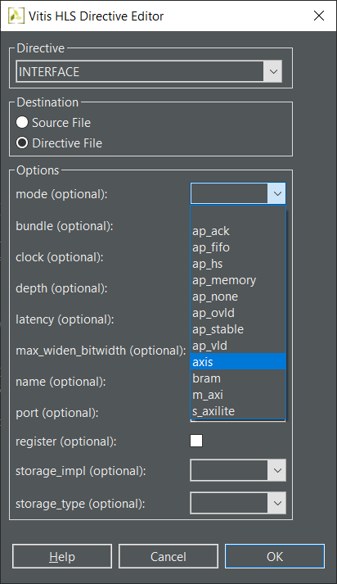

AXI4 Stream Interface: Ease of Use
Native Support for AXI4 Stream Interfaces
Native = An AXI4 Stream can be specified with set_directive_interface
No longer required to set the interface then add a resource
This AXI4 Stream interface is part of the HDL after synthesis
This AXI4 Stream interface is simulated by RTL co-simulation
Interface Type “axis” is AXI4 Stream
set_directive_interface –mode axis “foo” portA
Or
#pragma HLS interface mode=axis port=portA

Slide 50
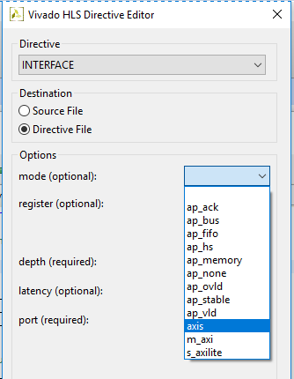
AXI4 Stream Interface: Ease of Use
Native Support for AXI4 Stream Interfaces
Native = An AXI4 Stream can be specified with set_directive_interface
No longer required to set the interface then add a resource
This AXI4 Stream interface is part of the HDL after synthesis
This AXI4 Stream interface is simulated by RTL co-simulation
Interface Type “axis” is AXI4 Stream
set_directive_interface –mode axis “foo” portA
Or
#pragma HLS interface mode=axis port=portA

Slide 51
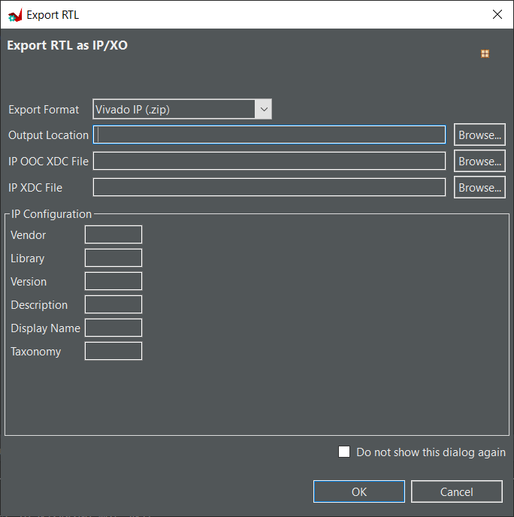
Generate the hardware accelerator
Select Solution > Export RTL
Select Vivado IP(.zip), Vivado IP for System Generator for Vivado
Select Output Location
Change the IP Configuration
Vendor/Library/Version/Description/Display Name/Taxonomy
Click on OK
The IP is exported as a ZIP file that can be added to the Vivado IP catalog.
The impl/ip folder also contains the contents of the unzipped IP.

Slide 52
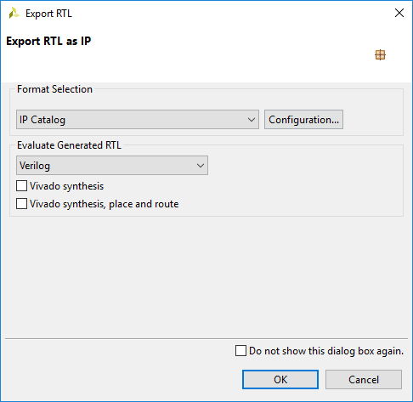
Generate the hardware accelerator
Select Solution > Export RTL
Select IP Catalog, System Generator for Vivado or design check point (dcp)
Select Vivado IP(.zip), Vivado IP for System Generator for Vivado
Select Output Location
Change the IP Configuration
Vendor/Library/Version/Description/Display Name/Taxonomy
Click on Configuration… if you want to change the version number or other information
Default is v1.0
Click on OK
The IP is exported as a ZIP file that can be added to the Vivado IP catalog.
The impl/ip folder also contains the contents of the unzipped IP.
The directory (ip) will be generated under the impl folder under the current project directory and current solution
RTL code will be generated, both for Verilog and VHDL languages in their respective folders

Slide 53
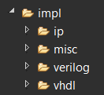
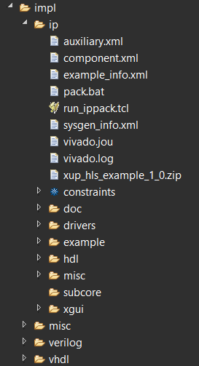


Generated impl Directory
Point IP Catalog to point to the ip directory
IP Integrator will use this file
VITIS will use this directory
Header file
Generated Verilog RTL Files

Slide 54




Generated impl Directory
Point IP Catalog to point to the ip directory
IP Integrator will use this file
XSDK will use this directory
Header file for slave interfaces
Generated Verilog RTL Files

Slide 55



C Driver API for AXI4-Lite Interface
Notes:
No such a table now

Slide 56
Integrating the IP-XACT Hardware Accelerator in AXI System

Slide 57
Embedded System Design using Vivado
Create a new Vivado project, or open an existing project
Invoke IP Integrator
Construct(modify) the hardware portion of the embedded design by adding the IP-XACT hardware accelerator created in Vitis HLS
Create (Update) top level HDL wrapper
Synthesize any non-embedded components and implement in Vivado
Export the hardware description(XSA File), and launch VITIS
Create a new platform project from XSA and application projects in the VITIS
Compile the software with the GNU cross-compiler in VITIS
Download the programmable logic’s completed bitstream using Xilinx Tools > Program FPGA in VITIS
Use VITIS to download and execute the program (the ELF file)

Slide 58
Embedded System Design using Vivado
Create a new Vivado project, or open an existing project
Invoke IP Integrator
Construct(modify) the hardware portion of the embedded design by adding the IP-XACT hardware accelerator created in Vitis HLS
Create (Update) top level HDL wrapper
Synthesize any non-embedded components and implement in Vivado
Export the hardware description(XSA File), and launch XSDKVITIS
Create a new platform project from XSA software board support package and application projects in the XSDKVITIS
Compile the software with the GNU cross-compiler in XSDKVITIS
Download the programmable logic’s completed bitstream using Xilinx Tools > Program FPGA in XSDKVITIS
Use XSDKVITIS to download and execute the program (the ELF file)

Slide 59
Summary

Slide 60
Summary
Embedded system development flow in FPGA involves
Developing hardware using IP Integrator and Vivado
Developing software using VITIS
hardware accelerator provides wide support of AXI interfaces, System Generator design, and design check point(dcp)
Use the INTERFACE directive
The choice of hardware accelerator is a function of the C variable type (pointer, etc.)
Start with the correct C argument type
Verify the design at the C level
Accept the default block-level I/O protocol
Select the port-level I/O protocol that gives the required hardware accelerator interface
Optionally group ports

Slide 61
Summary
Embedded system development flow in FPGA involves
Developing hardware using IP Integrator and Vivado
Developing software using XSDKVITIS
hardware accelerator provides wide support of AXI interfaces, System Generator design, and design check point(dcp)
Use the INTERFACE directive
The choice of hardware accelerator is a function of the C variable type (pointer, etc.)
Start with the correct C argument type
Verify the design at the C level
Accept the default block-level I/O protocol
Select the port-level I/O protocol that gives the required hardware accelerator interface
Optionally group ports

